Slide 1
Evolution of chemical, mineralogical and magnetic properties of electric arc furnace slag over weathering
Maud HERBELIN^{1*}, Jérôme BASCOU¹, Véronique LAVASTRE¹, Damien GUILLAUME¹, Frédéric ASTOLFI² ¹ Université de Lyon, UJM-Saint-Etienne, CNRS, UCA, IRD, LMV UMR 6524, 42023, Saint-Etienne, France ² INDUSTEEL FRANCE Groupe ArcelorMittal, B.P. 368, 42803 Rive de Gier, France
6th International Slag Valorisation Symposium
01-05 April 2019
Mechelen, Belgium
Notes:
Saint-Etienne is located in a former industrial region
Management of slagheaps is an important issue
Heavy metal contamination of soil and water

Slide 2
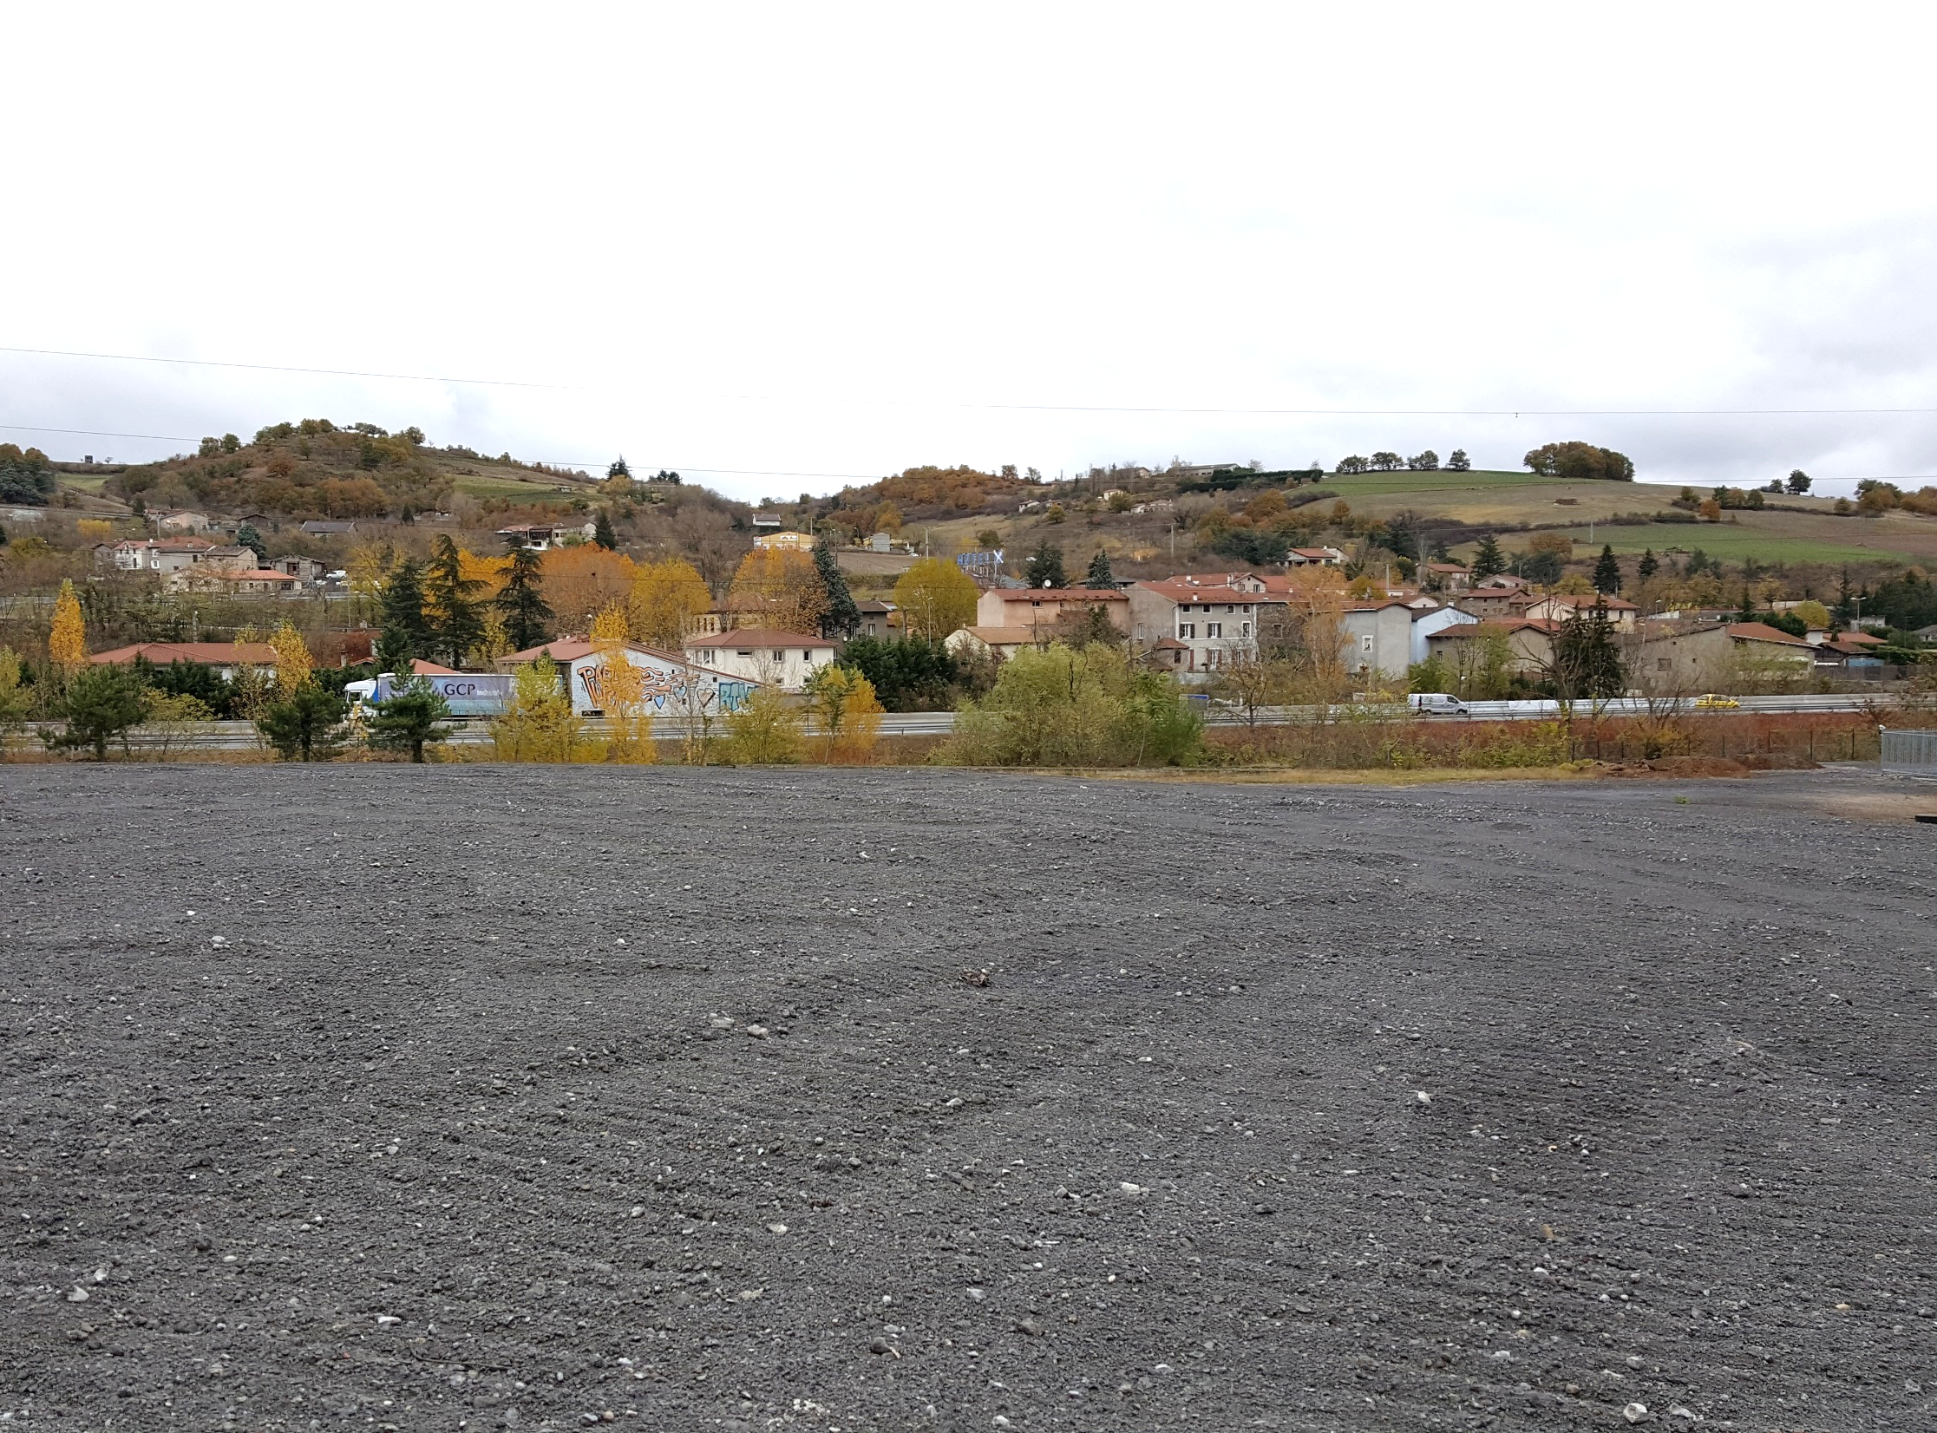
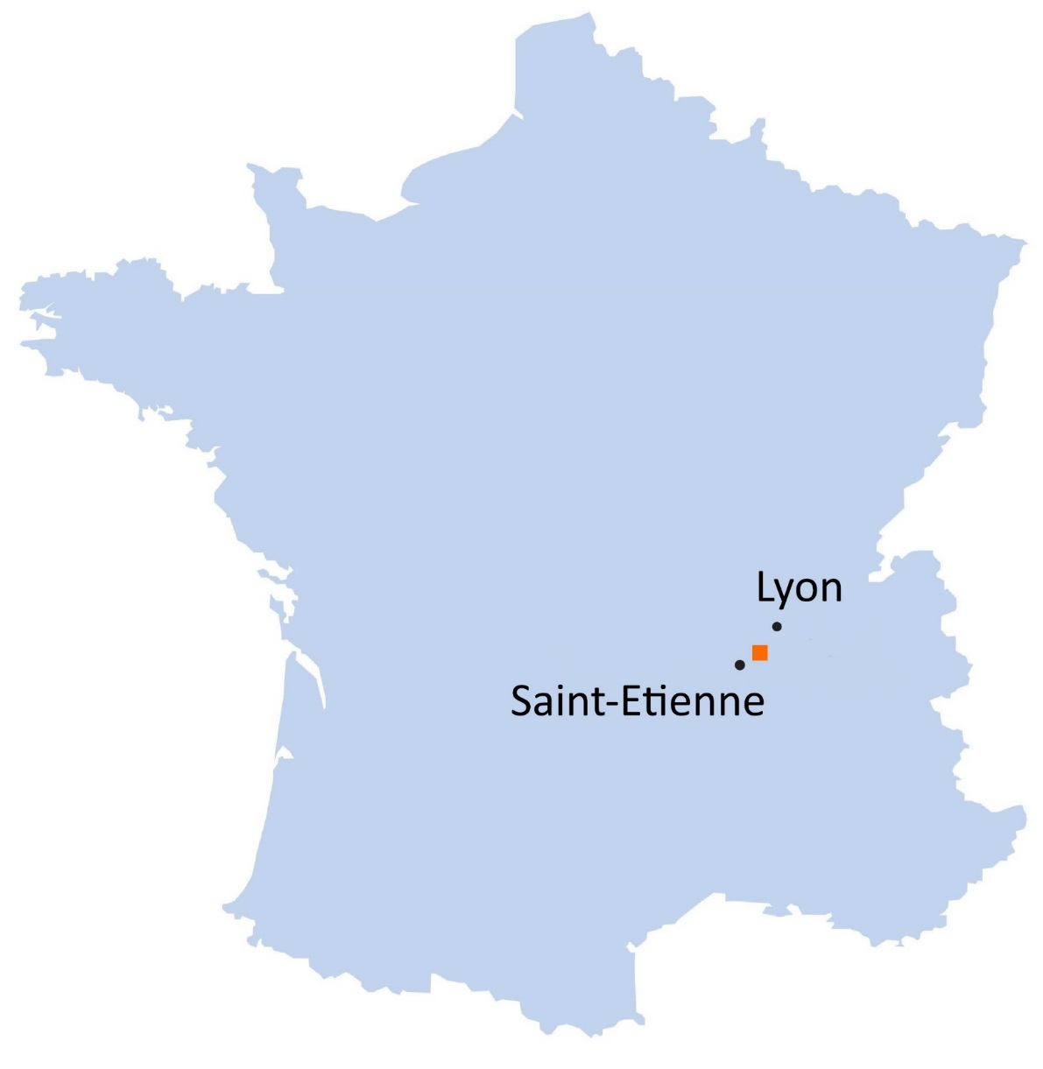
I. Context | II. Field analyses | III. Laboratory analyses | IV. Experimental tests | V. Conclusions and prospects
Châteauneuf steel-making site,
Industeel, (Loire, France)
Industeel Châteauneuf
Notes:
Need to deal with slag produced before 2006 which doesn’t meet current standards for traditional slag applications (too high chromium contents)

Slide 3
I. Context | II. Field analyses | III. Laboratory analyses | IV. Experimental tests | V. Conclusions and prospects
History
1960 to 1999 : slag landfilling
⬅ S-O
N-E ➔
Steel-making plant
Current slag treatment area
Studied area
Notes:
Need to deal with slag produced before 2006 which doesn’t meet current standards for traditional slag applications (too high chromium contents)

Slide 4
I. Context | II. Field analyses | III. Laboratory analyses | IV. Experimental tests | V. Conclusions and prospects
History
1960 to 1999 : slag landfilling
1999 : European Directive “Waste landfilling”
2006 : the process changes, slag is treated and recycled for construction
Notes:
Need to deal with slag produced before 2006 which doesn’t meet current standards for traditional slag applications (too high chromium contents)

Slide 5
I. Context | II. Field analyses | III. Laboratory analyses | IV. Experimental tests | V. Conclusions and prospects
History
1960 to 1999 : slag landfilling
1999 : European Directive “Waste landfilling”
2006 : the process changes, slag is treated and recycled for construction
Need to deal with slag produced before 2006 which can’t be recycled
Too high chromium contents
Risk of transfer toward water or soils
A too large volume to be transported and treated (>40000m³)
Notes:
Need to deal with slag produced before 2006 which doesn’t meet current standards for traditional slag applications (too high chromium contents)

Slide 6
I. Context | II. Field analyses | III. Laboratory analyses | IV. Experimental tests | V. Conclusions and prospects
History
1960 to 1999 : slag landfilling
1999 : European Directive “Waste landfilling”
2006 : the process changes, slag is treated and recycled for construction
Need to deal with slag produced before 2006 which can’t be recycled
Too high chromium contents
Risk of transfer toward water or soils
A too large volume to be transported and treated (>40000m³)
Need to know the long term behaviour of the material
Phytostabilisation project
Notes:
Need to deal with slag produced before 2006 which doesn’t meet current standards for traditional slag applications (too high chromium contents)

Slide 7
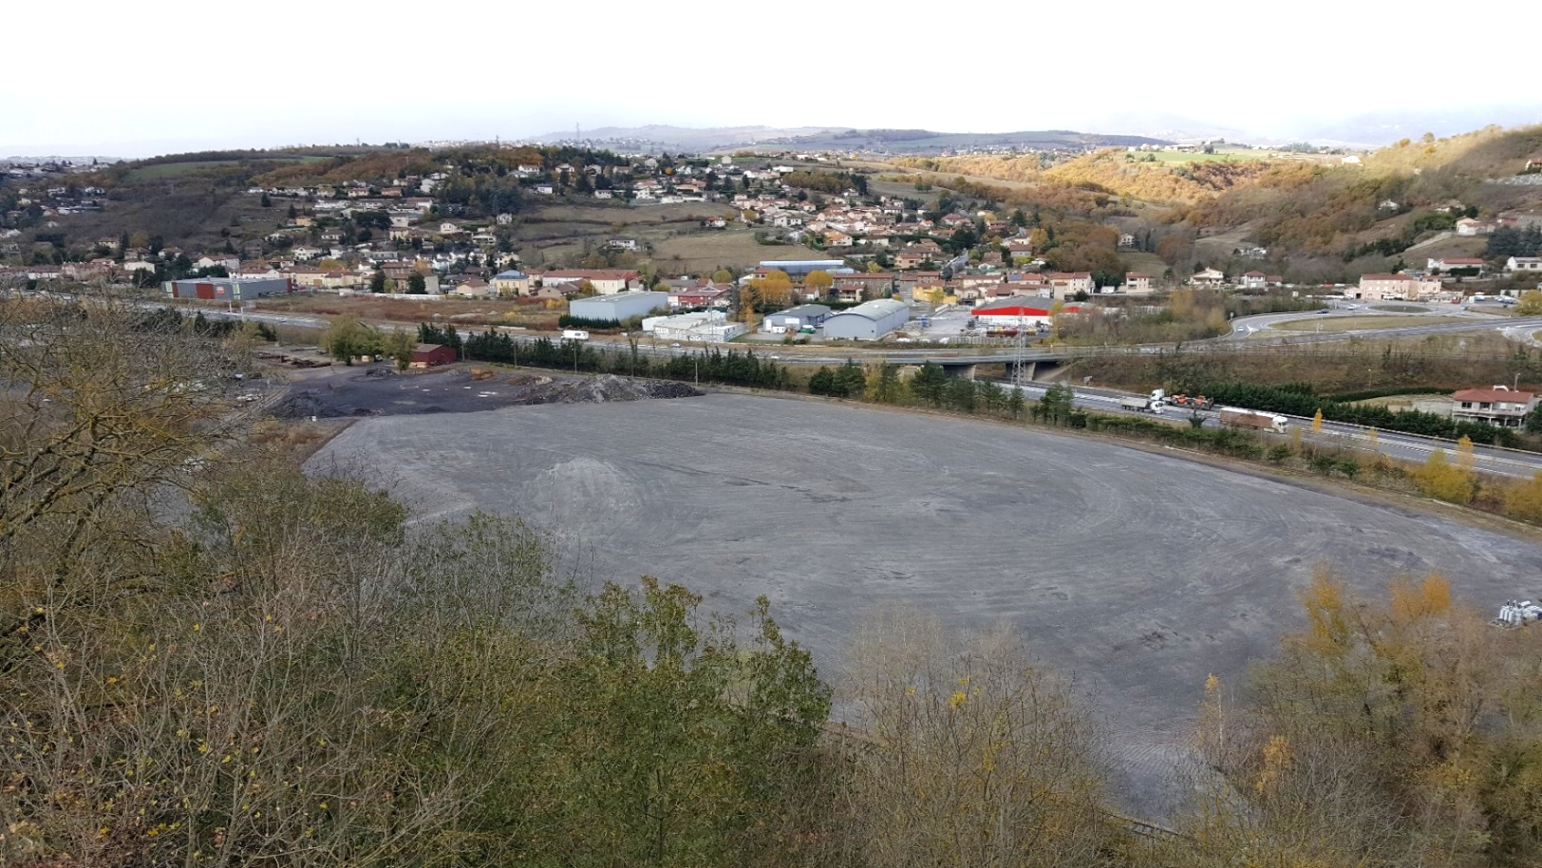
I. Context | II. Field analyses | III. Laboratory analyses | IV. Experimental tests | V. Conclusions and prospects
2016 : reshaping of the site
A47 highway
Gier river
200 m
Notes:
After several studies, phytostabilisation has been suggested as a possible solution
Ajouter échelle / situer rivière / route

Slide 8
I. Context | II. Field analyses | III. Laboratory analyses | IV. Experimental tests | V. Conclusions and prospects
Reshaping in 2016
Sieved fine slag
(ø < 40 mm)
Coarse slag
Sand, refractory bricks, various steel making wastes, rubble
Notes:
Superficial layer thickness ~20 cm (V = 6580m3 / S = 32050m2)
Middle layer ~ 20 cm
Base layer 0,5 – 1 m

Slide 9
I. Context | II. Field analyses | III. Laboratory analyses | IV. Experimental tests | V. Conclusions and prospects
Study focused on the upper layer :
How to characterise such a large surface ?
Sampling and laboratory analyses ➔ costly and time consuming
Field analyses ➔ less precise, but much quicker
Sieved fine slag
(ø < 40 mm)
Coarse slag
Sand, refractory bricks, various steel making wastes, rubble
Notes:
Superficial layer thickness ~20 cm (V = 6580m3 / S = 32050m2)
Middle layer ~ 20 cm
Base layer 0,5 – 1 m

Slide 10
I. Context | II. Field analyses | III. Laboratory analyses | IV. Experimental tests | V. Conclusions and prospects
Study focused on the upper layer :
How to characterise such a large surface ?
Field and laboratory :
Coupled magnetic and chemical measures as a mapping tool
Laboratory :
leaching tests to study metallic elements mobility
Sieved fine slag
(ø < 40 mm)
Coarse slag
Sand, refractory bricks, various steel making wastes, rubble
Notes:
Superficial layer thickness ~20 cm (V = 6580m3 / S = 32050m2)
Middle layer ~ 20 cm
Base layer 0,5 – 1 m

Slide 11
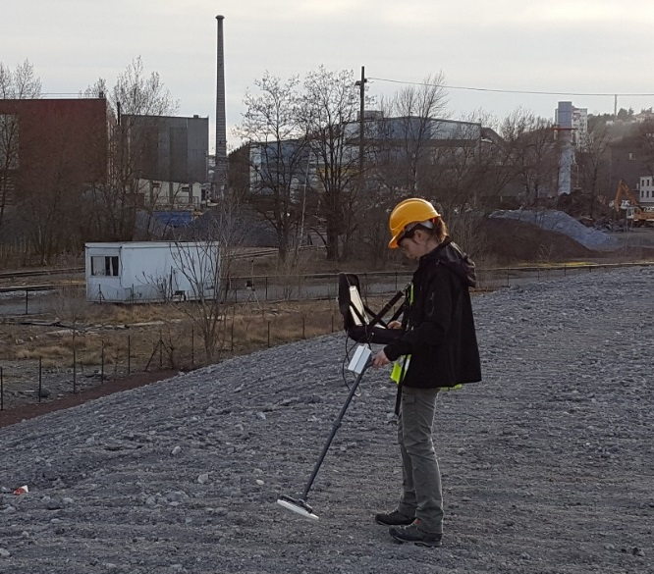
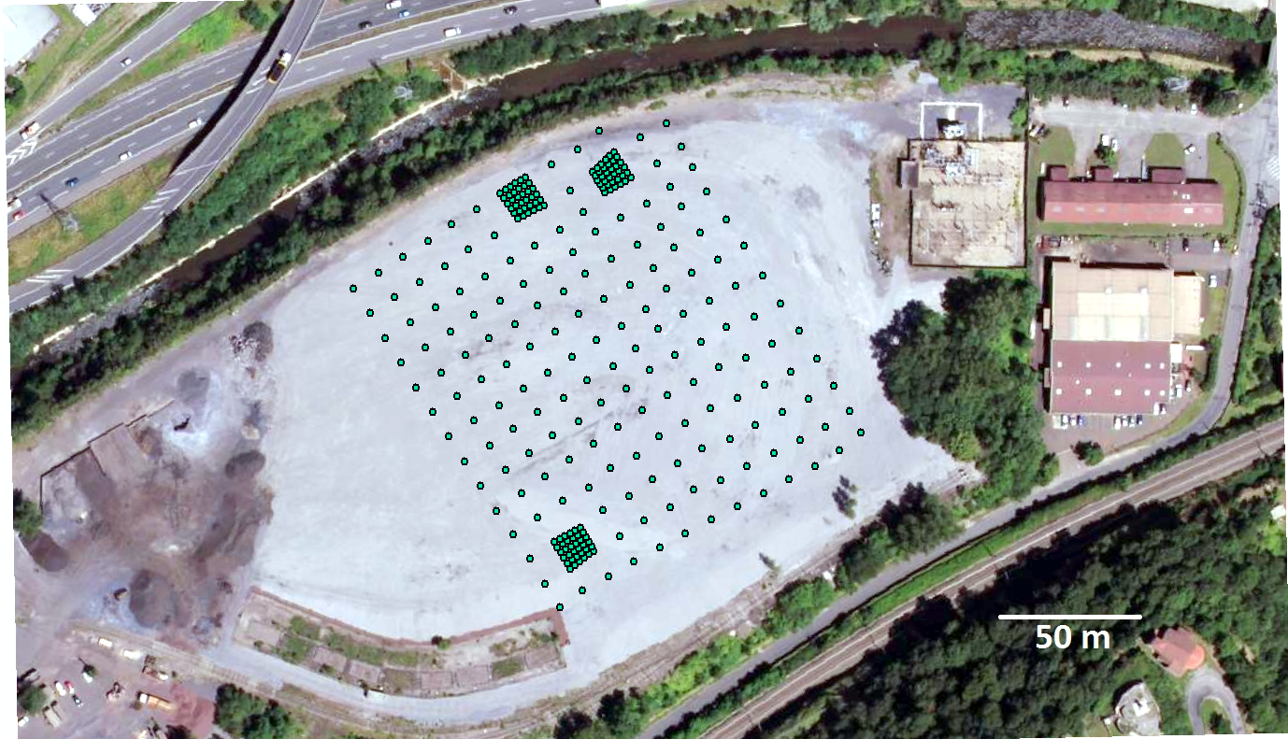
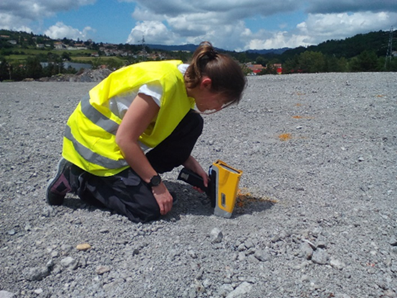
I. Context | II. Field analyses | III. Laboratory analyses | IV. Experimental tests | V. Conclusions and prospects
Magnetic susceptibility measurements with Bartington MS3 D loop sensor
181 measurement points (10m apart)
63 points measurements in specific place (2m apart)
Chemical analyses with portable XRF Olympus Vanta on a roughly homogenised and flattened surface
Notes:
Mesures de surface (de grains)

Slide 12
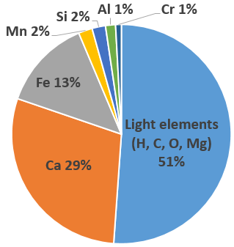
I. Context | II. Field analyses | III. Laboratory analyses | IV. Experimental tests | V. Conclusions and prospects
Field results
Average chemical composition (XRF analyses)
Notes:
K dimensionless (dM/dH) 1SI = (1/4Pi)cgs

Slide 13
I. Context | II. Field analyses | III. Laboratory analyses | IV. Experimental tests | V. Conclusions and prospects
Field results
Surface magnetic susceptibility κ [10⁻³ SI]
Average | 69
Maximum | 116
Minimum | 27
Standard deviation | 10
Average chemical composition (XRF analyses)
Notes:
K dimensionless (dM/dH) 1SI = (1/4Pi)cgs

Slide 14
I. Context | II. Field analyses | III. Laboratory analyses | IV. Experimental tests | V. Conclusions and prospects
Field results
Surface magnetic susceptibility κ [10⁻³ SI]
Average | 69
Maximum | 116
Minimum | 27
Standard deviation | 10
Some common magnetic susceptibility values [10⁻³ SI]
Metallic ironª | Ferromagnetic | 3900
Magnetiteª (Fe₃O₄) | Ferrimagnetic | 3000
Hematiteª (Fe₂O₃) | Antiferromagnetic | 0,5 - 40
Average chemical composition (XRF analyses)
ª Dunlop, D. J. et al. (2007) ‘5.08 Magnetizations in Rocks and Minerals’.
Notes:
Graphique !
K dimensionless (dM/dH) 1SI = (1/4Pi)cgs

Slide 15
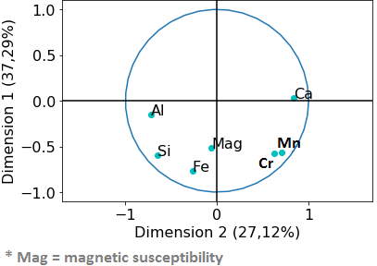
I. Context | II. Field analyses | III. Laboratory analyses | IV. Experimental tests | V. Conclusions and prospects
Principal Components Analysis (multivariate statistics analysis)
Correlation circle for field results
➔ Correlation between magnetic susceptibility and Fe
➔ Between Cr and Mn
Notes:
Field PCA in agreement with kriging results

Slide 16
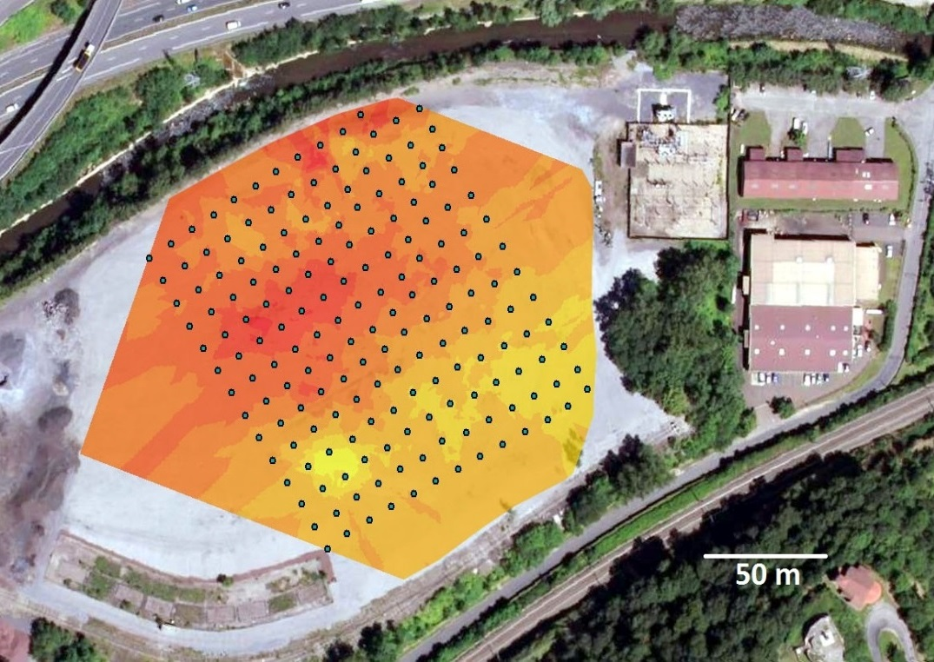
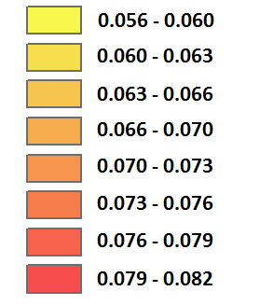
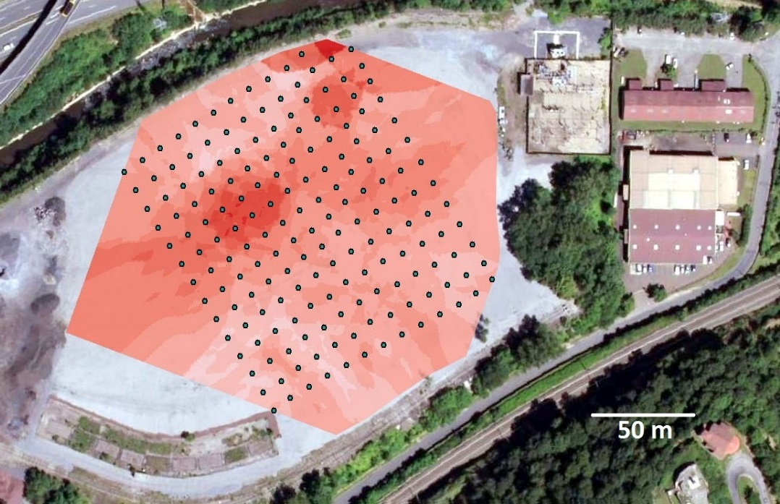
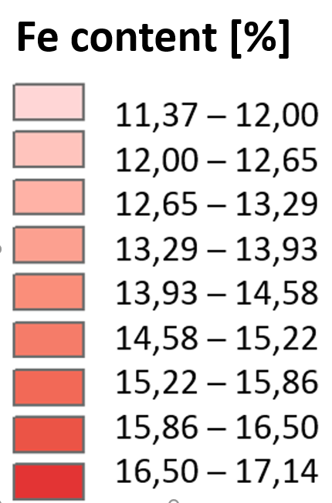
I. Context | II. Field analyses | III. Laboratory analyses | IV. Experimental tests | V. Conclusions and prospects
Field results interpolation (kriging)
Magnetic susceptibility [SI]
A relatively homogeneous surface
Clear correlation between magnetic susceptibility and iron contents
XRF field analyses seem statistically reliable for iron

Slide 17
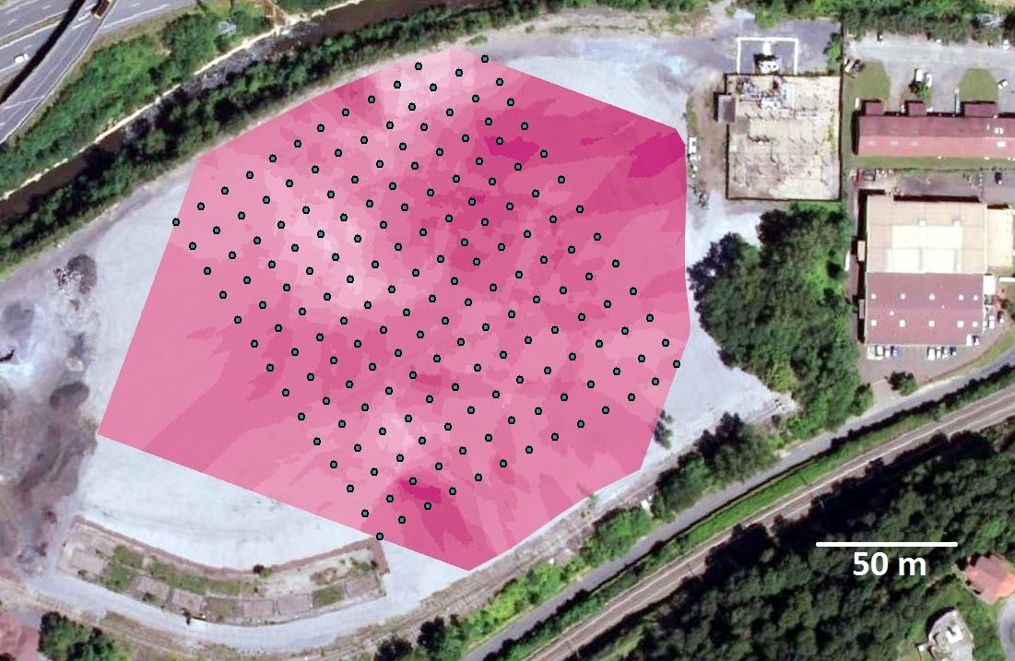
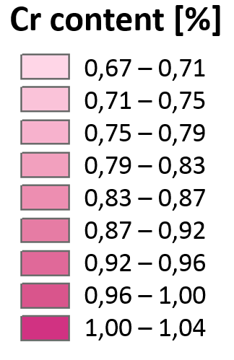
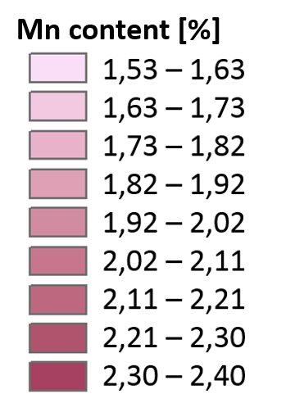
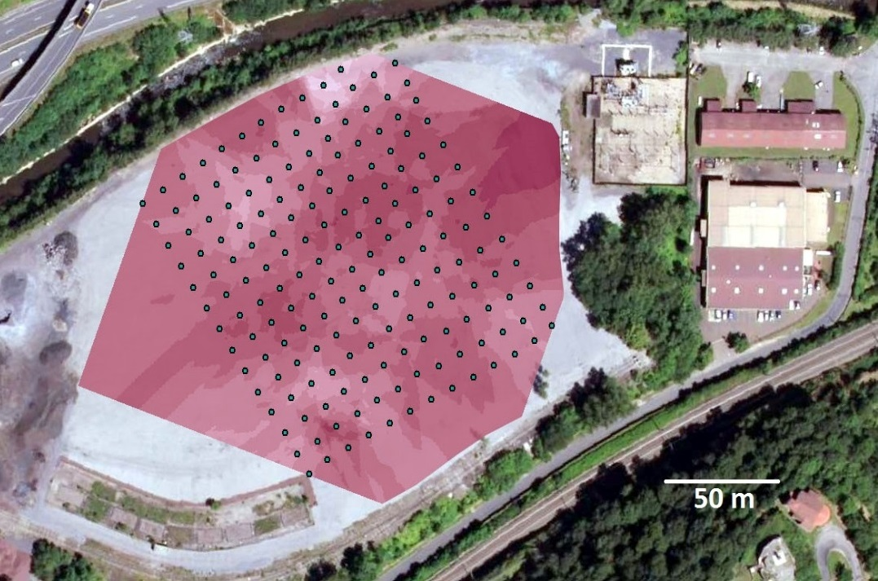
I. Context | II. Field analyses | III. Laboratory analyses | IV. Experimental tests | V. Conclusions and prospects
Field results interpolation (kriging)
Magnetic susceptibility [SI]
Notes:
Mn – Cr pas systématiquement corrélé

Slide 18
I. Context | II. Field analyses | III. Laboratory analyses | IV. Experimental tests | V. Conclusions and prospects
Coupled magnetic and chemical measurements enabled a quick reconnaissance of the field
The material is relatively homogeneous

Slide 19
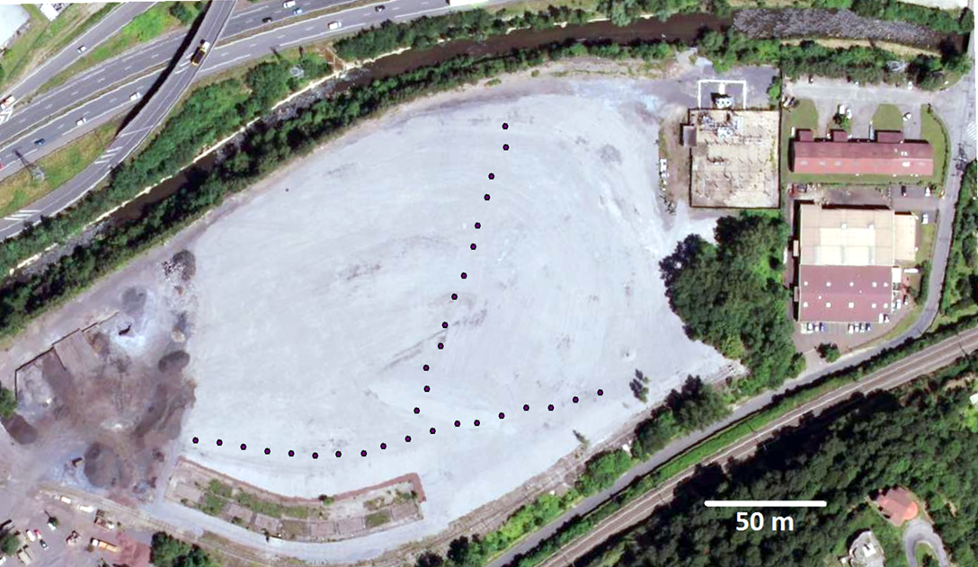
I. Context | II. Field analyses | III. Laboratory analyses | IV. Experimental tests | V. Conclusions and prospects
31 sampling points, 10m apart, according to 2 directions

Slide 20
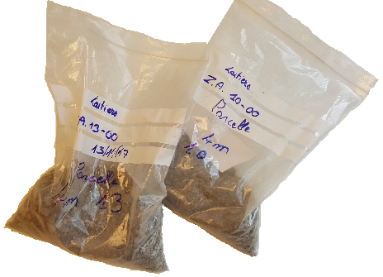
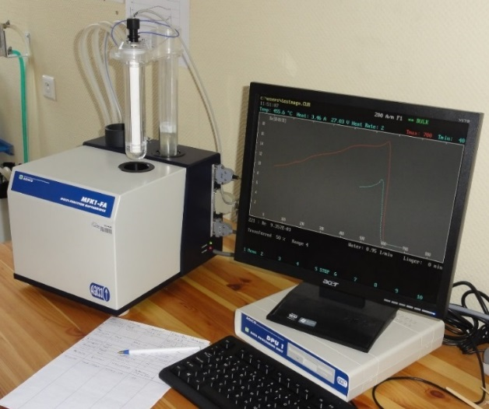
I. Context | II. Field analyses | III. Laboratory analyses | IV. Experimental tests | V. Conclusions and prospects
Magnetic susceptibility measurement with Agico MKF1-FA Kappabridge
31 sampling points, 10m apart, according to 2 directions

Slide 21
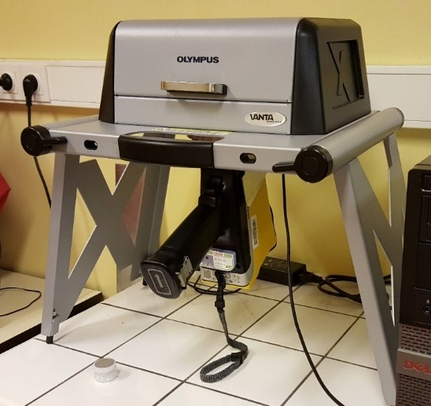
I. Context | II. Field analyses | III. Laboratory analyses | IV. Experimental tests | V. Conclusions and prospects
Magnetic susceptibility measurement with Agico MKF1-FA Kappabridge
Fine crushing
Chemical analyses
with pXRF Olympus Vanta Serie M
31 sampling points, 10m apart, according to 2 directions

Slide 22
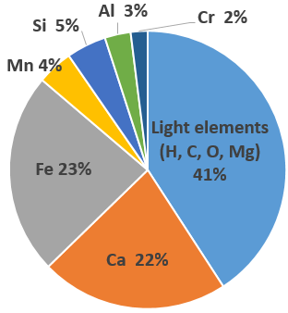
I. Context | II. Field analyses | III. Laboratory analyses | IV. Experimental tests | V. Conclusions and prospects
Laboratory results
Average chemical composition (XRF analyses)

Slide 23
I. Context | II. Field analyses | III. Laboratory analyses | IV. Experimental tests | V. Conclusions and prospects
Laboratory results
Average chemical composition (XRF analyses)
Field results

Slide 24
I. Context | II. Field analyses | III. Laboratory analyses | IV. Experimental tests | V. Conclusions and prospects
Laboratory results
Mass specific magnetic susceptibility χ [10⁻⁶ m³/kg]
Average | 59
Maximum | 78
Minimum | 47
Standard deviation | 6
Some common magnetic susceptibility values [10⁻⁶ m³/kg]
Magnetiteª (Fe₃O₄) | Ferrimagnetic | 580
Metallic ironª | Ferromagnetic | 500
Hematiteª (Fe₂O₃) | Antiferromagnetic | 0,10 – 7,60
Topsoils^{b} |  | 0,01 - 20
Average chemical composition (XRF analyses)
ª Dunlop, D. J. et al. (2007) ‘5.08 Magnetizations in Rocks and Minerals’.
^{b} Dearing, J. A. (1994). Environmental magnetic susceptibility: using the Bartington MS2 system. Chi Pub.
Notes:
Ajouter courbe k/T
Topsoil ➔ montrer qu’on est largement au dessus

Slide 25
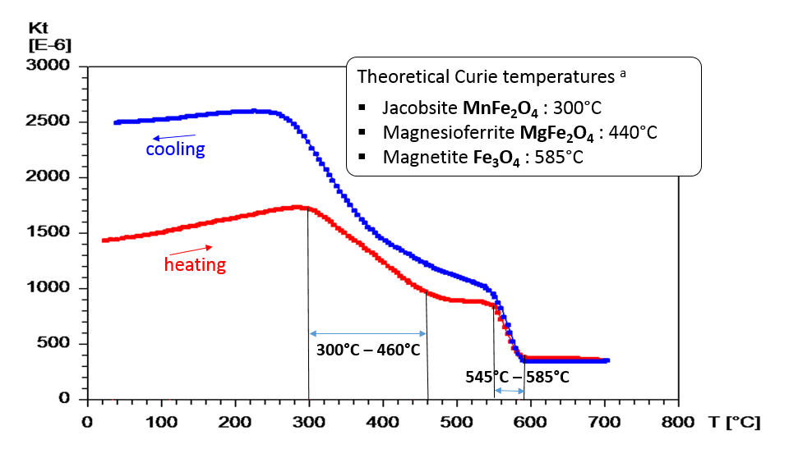
I. Context | II. Field analyses | III. Laboratory analyses | IV. Experimental tests | V. Conclusions and prospects
Thermomagnetic study
Presence of pure magnetite
Presence of a solid solution of (Mn,Mg)_{x}Fe_{1-x}Fe₂O₄ with 0 < x < 1
ª Cullity, B.D., Graham, C.D., 2009. Introduction to magnetic materials, 2. ed. ed. IEEE Press, Piscataway, NJ. p183

Slide 26
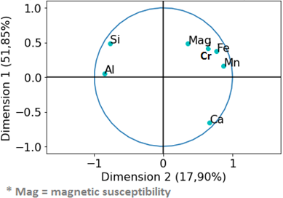
I. Context | II. Field analyses | III. Laboratory analyses | IV. Experimental tests | V. Conclusions and prospects
Principal Components Analysis
Correlation circle for laboratory results

Slide 27
I. Context | II. Field analyses | III. Laboratory analyses | IV. Experimental tests | V. Conclusions and prospects
Principal Components Analysis
Correlation circle for laboratory results
Global correlation between magnetic susceptibility and Fe, Cr, Mn
How are these elements associated in minerals ?

Slide 28
I. Context | II. Field analyses | III. Laboratory analyses | IV. Experimental tests | V. Conclusions and prospects
Mineralogy study
SEM – BSE micrograph
According to EDX and XRD analyses :
Fe – Mn - Mg oxide
(magnetite/jacobsite/hematite)
magnetic mineral phases
Chromite
(Fe, Mg)Cr₂O₄
Srebrodolskite Ca₂(Fe,Cr)₂O₅
Larnite
Ca₂SiO₄
Notes:
Ajouter RAMAN
Mn associated to Fe
Cr associated to Fe (and Ca)
Exsolutions of srebrodolskite in iron oxides ?

Slide 29
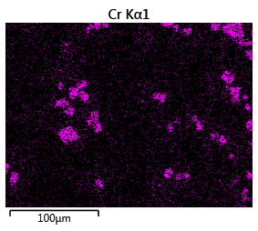
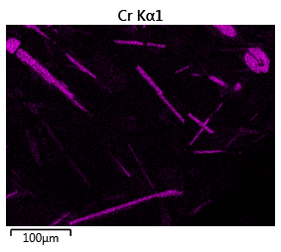
I. Context | II. Field analyses | III. Laboratory analyses | IV. Experimental tests | V. Conclusions and prospects
Mineralogy study : Chromium location ?
SEM – BSE micrographies
EDX maps
Chromite
(Fe, Mg)Cr₂O₄ ➔ Cr III
hardly soluble mineral
Calcium chromite CaCr₂O₄ ➔ Cr III
or chromatite CaCrO₄ ➔ Cr VI
Cr more likely to be solubilized
Notes:
Chromite is an hardly soluble mineral / Cr on this form is very stable

Slide 30
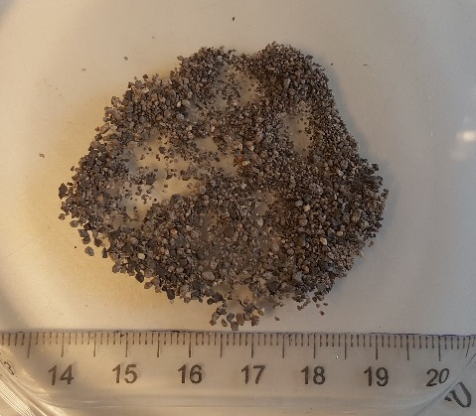
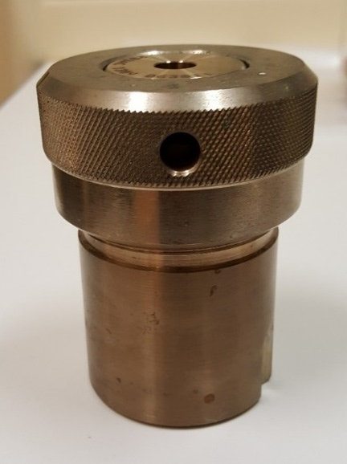
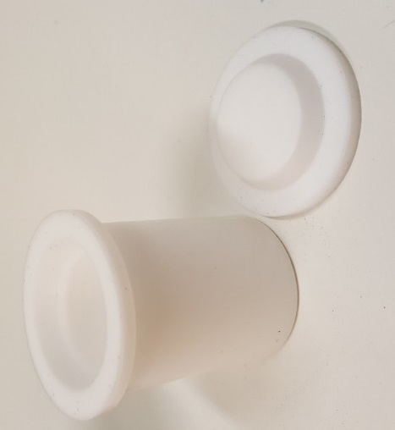
I. Context | II. Field analyses | III. Laboratory analyses | IV. Experimental tests | V. Conclusions and prospects
Leaching tests in autoclaves
0,250 – 1,25 mm slag grains
Deionised water
L/S = 10

Slide 31
I. Context | II. Field analyses | III. Laboratory analyses | IV. Experimental tests | V. Conclusions and prospects
Leaching tests in autoclaves
9 tests
Leaching temperatures 40°C 60°C 110°C | Leaching times 24h 7 days 1 month
0,250 – 1,25 mm slag grains
➔ Increasing kinetics
Deionised water
L/S = 10

Slide 32
I. Context | II. Field analyses | III. Laboratory analyses | IV. Experimental tests | V. Conclusions and prospects
Leaching tests in autoclaves
9 tests
Leaching temperatures 40°C 60°C 110°C | Leaching times 24h 7 days 1 month
0,250 – 1,25 mm slag grains
➔ Increasing kinetics
➔ ICP-AES analyses of the resulting liquid
➔ SEM and XRD analyses of the resulting solid
Deionised water
L/S = 10

Slide 33
I. Context | II. Field analyses | III. Laboratory analyses | IV. Experimental tests | V. Conclusions and prospects
Leaching results
No visible mineralogy difference between initial and leached material

Slide 34
I. Context | II. Field analyses | III. Laboratory analyses | IV. Experimental tests | V. Conclusions and prospects
Leaching results
No visible mineralogy difference between initial and leached material
Very low metal extraction
Only Ca and Cr concentrations were significant

Slide 35
I. Context | II. Field analyses | III. Laboratory analyses | IV. Experimental tests | V. Conclusions and prospects
Leaching results
No visible mineralogy difference between initial and leached material
Very low metal extraction
Only Ca and Cr concentrations were significant
Average = 0,16%
Notes:
Ca extraction stabilized
(respectively 30 to 40 ppm and 1 to 8 ppm)

Slide 36
I. Context | II. Field analyses | III. Laboratory analyses | IV. Experimental tests | V. Conclusions and prospects
Leaching results
Preferential leaching of Cr when associated to Ca
Average = 0,16%
Notes:
(respectively 30 to 40 ppm and 1 to 8 ppm)

Slide 37
I. Context | II. Field analyses | III. Laboratory analyses | IV. Experimental tests | V. Conclusions and prospects
Magnetic measurements showed a relatively homogeneous slagheap surface

Slide 38
I. Context | II. Field analyses | III. Laboratory analyses | IV. Experimental tests | V. Conclusions and prospects
Magnetic measurements showed a relatively homogeneous slagheap surface
High global magnetic susceptibility of the material

Slide 39
I. Context | II. Field analyses | III. Laboratory analyses | IV. Experimental tests | V. Conclusions and prospects
Magnetic measurements showed a relatively homogeneous slagheap surface
High global magnetic susceptibility of the material
As expected, high magnetic susceptibility values are associated to high iron values
➔ Reliability of field chemical analyses

Slide 40
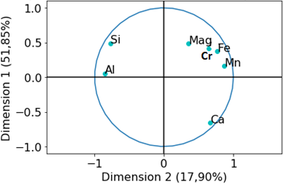
I. Context | II. Field analyses | III. Laboratory analyses | IV. Experimental tests | V. Conclusions and prospects
Correlations with other metal elements (Cr, Mn) need to be clarified
Laboratory results ➔ bulk analyses
Field results ➔ surface analyses
Notes:
Field PCA in agreement with kriging results

Slide 41
I. Context | II. Field analyses | III. Laboratory analyses | IV. Experimental tests | V. Conclusions and prospects
Correlations with other metal elements (Cr, Mn) need to be clarified
Laboratory results ➔ bulk analyses
Field results ➔ surface analyses
Further leaching tests will help to understand alteration processes
Notes:
Field PCA in agreement with kriging results

Slide 42
Thanks for your attention
Acknowledgements
June Chevet (LMV, Saint-Etienne, France) for sample preparation in clean room,
Mhammed Benbakkar and Jean-Luc Piro (LMV, Clermont-Ferrand, France) for the ICP-AES and ICP-MS analyses
Steve Peuble and Olivier Valfort (EMSE, Saint-Etienne, France) for SEM and XRD analyses

Slide 43
References
Cao, L., Appel, E., Hu, S., Yin, G., Lin, H. and Rösler, W. "Magnetic response to air pollution recorded by soil and dust-loaded leaves in a changing industrial environment", Atmos. Environ. 119, 304–313 (2015).
Cullity, B.D., Graham, C.D., 2009. Introduction to magnetic materials, 2. ed. ed. IEEE Press, Piscataway, NJ. p183
Dunlop, D. J. et al. (2007) ‘5.08 Magnetizations in Rocks and Minerals’.
Dearing, J. A. (1994). Environmental magnetic susceptibility: using the Bartington MS2 system. Chi Pub.
Engström, F., Adolfsson, D., Yang, Q., Samuelsson, C., and Björkman, B. Crystallization behaviour of some steelmaking slags. steel research international, 81(5), 362-371 (2010).
Jordanova, D., Jordanova, N. and Petrov, P. "Magnetic susceptibility of road deposited sediments at a national scale - Relation to population size and urban pollution", Environ. Pollut. 189, 239–251 (2014).
Houecande, D. O. "Chimie de l'eau et transport particulaire en sol contaminé: de la zone non saturée à la zone saturée - application au site atelier de Châteauneuf", Thesis. Université de Lyon. (2016).
Mombelli, D., Mapelli C., Barella, S., Di Cecca, C., Le Saout, G. and Garcia-Diaz, E. "The effect of microstructure on the leaching behaviour of electric arc furnace (EAF) carbon steel slag", Process Safety and Environmental Protection. Institution of Chemical Engineers, 102, pp. 810–821. (2016).

Slide 44
Principal Components Analyses
Principal component analysis (PCA) is a statistical procedure that uses an orthogonal transformation to convert a set of observations of possibly correlated variables
Each parameter is considered as a dimension of the space :
7 parameters = space in 7 dimensions
PCA makes a projection of the data in a 2 dimensions plan = 2 principal components = 2 vectors x and y
x = (1;0) et y = (0;1)
Each of the 7 dimensions is a linear combination of the 2 principal components :
Ex : Al = ax + by

Slide 45
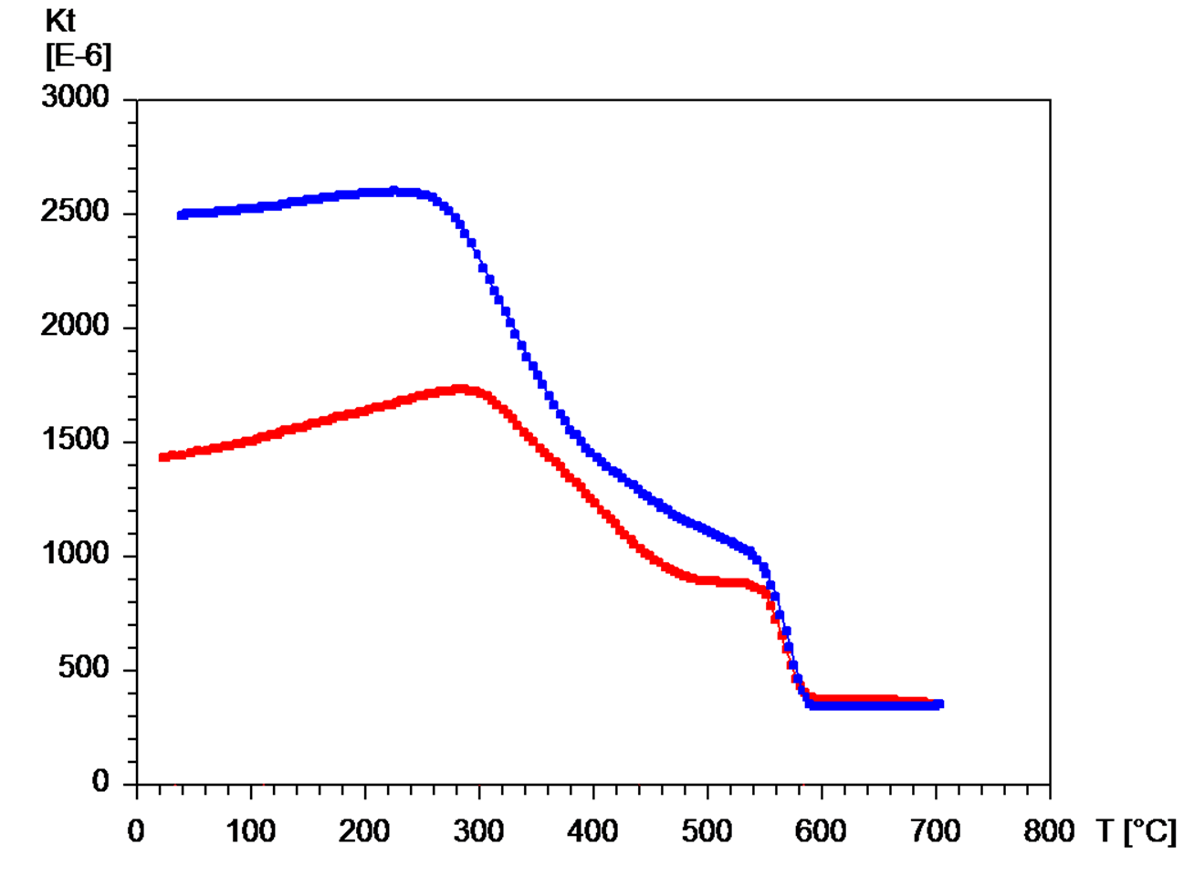
Theoretical Curie temperatures ª
Jacobsite MnFe₂O₄ : 300°C
Magnesioferrite MgFe₂O₄ : 440°C
Magnetite Fe₃O₄ : 585°C
cooling
heating
300°C – 460°C
545°C – 585°C
ª Cullity, B.D., Graham, C.D., 2009. Introduction to magnetic materials, 2. ed. ed. IEEE Press, Piscataway, NJ. p183

